Slide 1


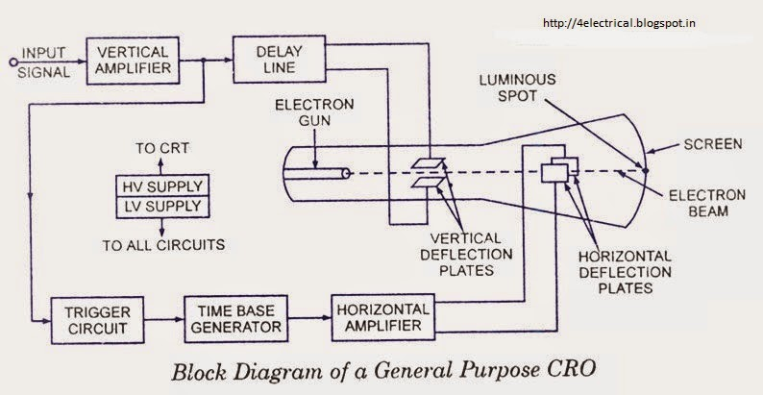
G.H.Raisoni College of Engineering and Management, Pune (An Autonomous Institute Affiliated to Savitribai Phule Pune University)
(1st Year Department)
Sub:-Engineering Physics
CRO(Cathode Ray Oscilloscope)
What is CRO ?
Cathode Ray Oscilloscope is a very important electronic measuring instrument which is used to display and measure electrical signals, time intervals and phase shift between two electrical signals.
Non electrical quantities such as pressure, strain and temperature can be measured by first converting them into an voltage using an appropriate transducer.
Application of CRO :-
The CRO is used to measure the voltage, current, frequency, inductance, admittance, power factor.
The CRO’s are used in huge applications like radio stations for observing the transmit the properties of signals.
This device is also used to check the AM and FM circuits characteristics.
This device is used to monitor the signal properties as well as characteristics and also analog signals.
The CRO is used through the resonance circuit to view the shape of the signal, bandwidth.
It is used in TV, Radar, and analysis of engine pressure.
In the hysteresis loop, it is used to find BH curves.
To check the reactions of nervous and heartbeat.
Used for comparing phase & frequency.
Advantages :-
Measurement of phase and frequency.
Training requirements.
Assurance for regulatory compliance.
Disadvantages :-
They are complicated to repair once it gets damaged.
These devices need complete isolation.
These are huge, heavy and uses more power
Guided By:-Prof. Praveen Jangade.
Presented By:-
Sushma D. Yemmewar (C-69)
Swayam P. Terode (C-70)
Tanmay R. Aswale (C-71)
Vallabh R. Shrimangale (C-72)

